Slide 1
Air Quality IQ
Drew Meyers, James Draper, Jeremy Udis

Slide 2
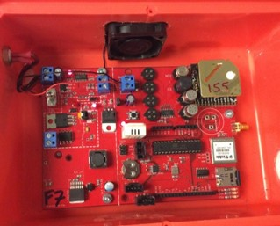
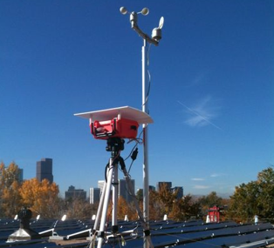
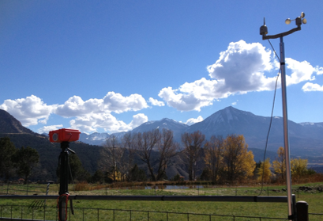

Slide 3






Tools
Project Tracking: Trello 🌟🌟🌟🌟
VCS Repository: Github 🌟🌟🌟🌟
Database: MySQL 🌟🌟🌟🌟
Testing Environment: PHPunit 🌟
Auto-documenter: Doxygen 🌟
Deployment Environment: Amazon Web Services 🌟🌟🌟🌟
Methodology: Waterfall

Slide 4
Challenges
Working with highcharts
Learning both JavaScript and PHP
Unit testing seemed like a huge waste of time
Meeting up was sometimes a problem
At first github was a problem, although we slowly learned how to use it
All the code had to be on a remote desktop, which only one person could use at a time. This lead to a lot of pair programming

Slide 5
Demo
Link

